Slide 1
Introduction to SVM classifier

Slide 2
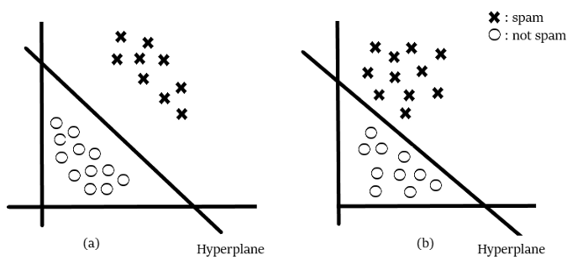
SVM is a supervised learning algorithm
based on the idea of finding a hyperplane that best separates the features into different domains.
Optimal hyperplane

Slide 3
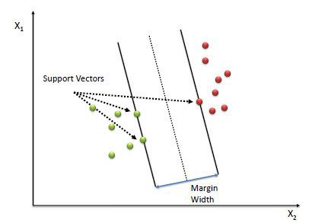
The points closest to the hyperplane are called support vector points or simply support vectors.
The distance between the support vector and the hyperplane is called margin.
margin maximizing hyperplane

Slide 4
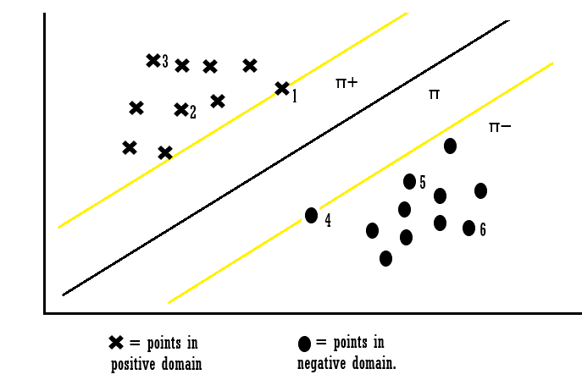

A hyperplane in m-dimensional space is given as,
$y=w_{0}+w_{1}x_{1}+w_{2}x_{2}+…+w_{m}x_{m}$
$y=w_{0}+\sum_{i=1}^{m}{w_{i}x_{i}}=w_{0}{+W}^{T}X$
$y=b+W^{T}X$

Slide 5
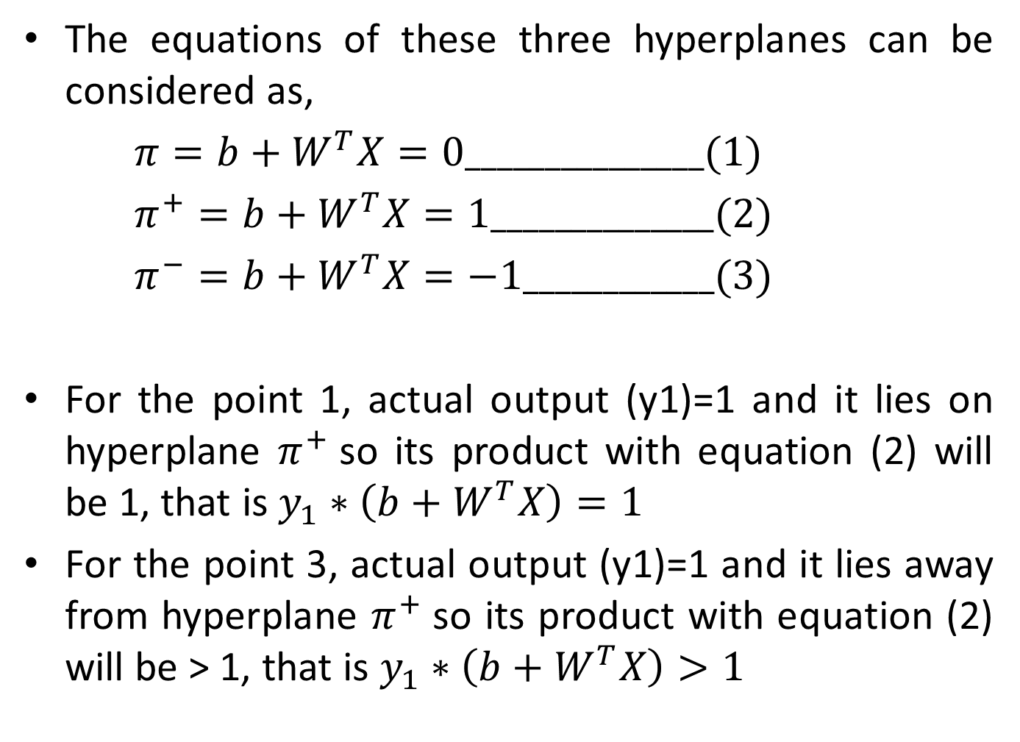
The equations of these three hyperplanes can be considered as,
$π=b+W^{T}X=0_______________(1)$
$π^{+}=b+W^{T}X=1______________(2)$
$π^{−}=b+W^{T}X=−1____________(3)$
For the point 1, actual output (y1)=1 and it lies on hyperplane $π^{+}$so its product with equation (2) will be 1, that is $y_{1}∗\left(b+W^{T}X\right)=1$
For the point 3, actual output (y1)=1 and it lies away from hyperplane $π^{+}$so its product with equation (2) will be > 1, that is $y_{1}∗\left(b+W^{T}X\right)>1$

Slide 6
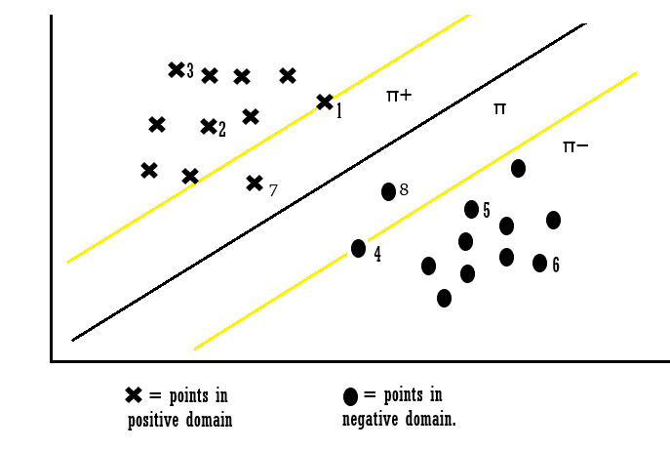

For the point 4, actual output (y1)=-1 and it lies on hyperplane $π^{−}$so its product with equation (3) will be 1, that is $y_{1}∗\left(b+W^{T}X\right)=1$
For the point 6, actual output (y1)=-1 and it lies away from hyperplane $π^{−}$so its product with equation (3) will be > 1, that is $y_{1}∗\left(b+W^{T}X\right)>1$

Slide 7
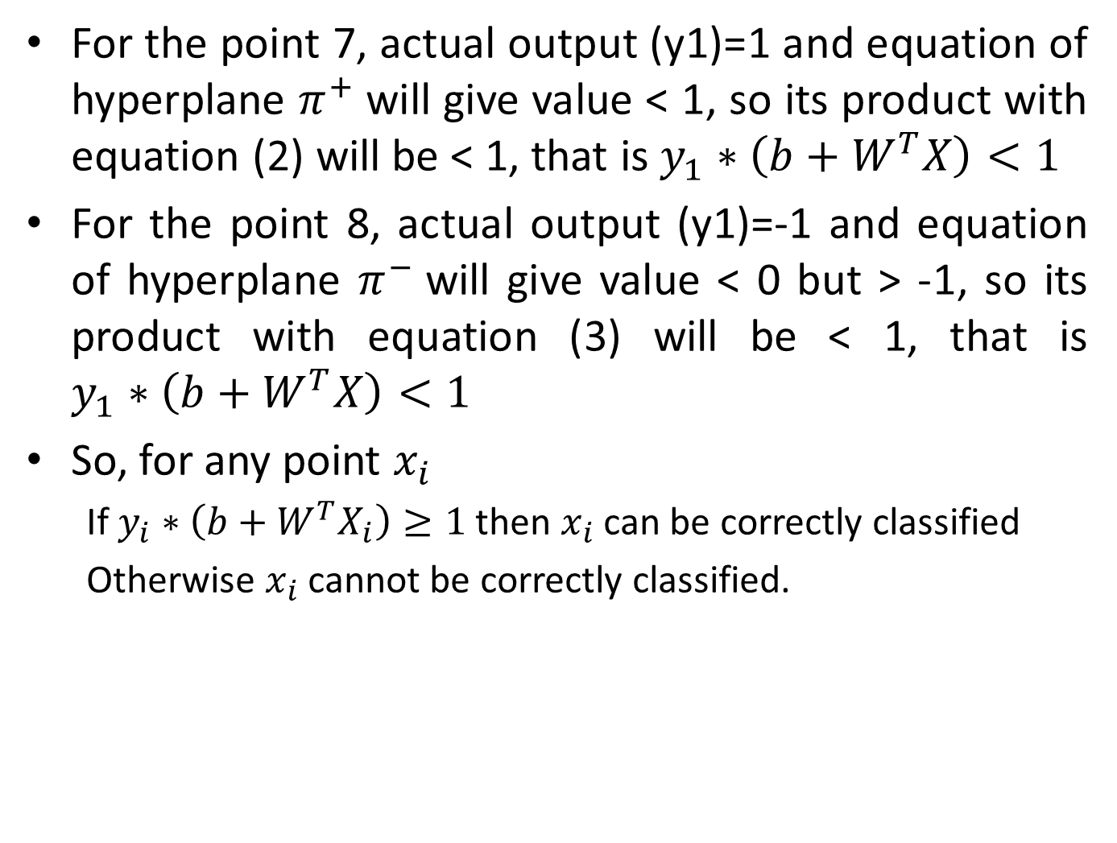
For the point 7, actual output (y1)=1 and equation of hyperplane $π^{+}$will give value < 1, so its product with equation (2) will be < 1, that is $y_{1}∗\left(b+W^{T}X\right)<1$
For the point 8, actual output (y1)=-1 and equation of hyperplane $π^{−}$will give value < 0 but > -1, so its product with equation (3) will be < 1, that is $y_{1}∗\left(b+W^{T}X\right)<1$
So, for any point $x_{i}$
If $y_{i}∗\left(b+W^{T}X_{i}\right)≥1$ then $x_{i}$ can be correctly classified
Otherwise $x_{i}$ cannot be correctly classified.

Slide 8
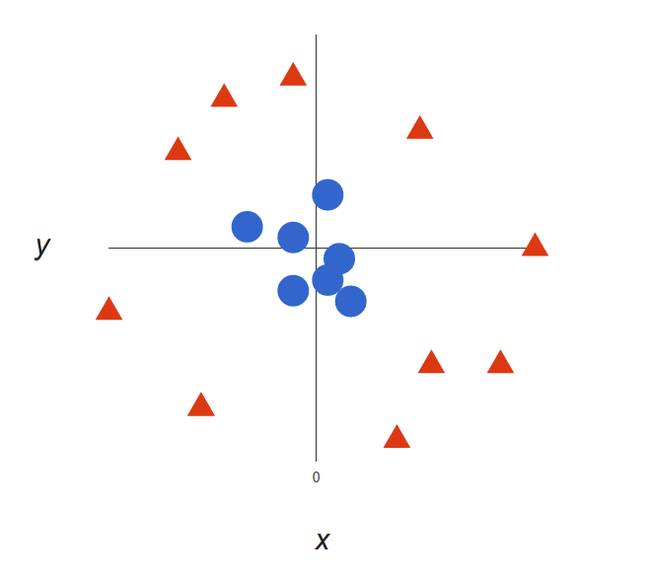
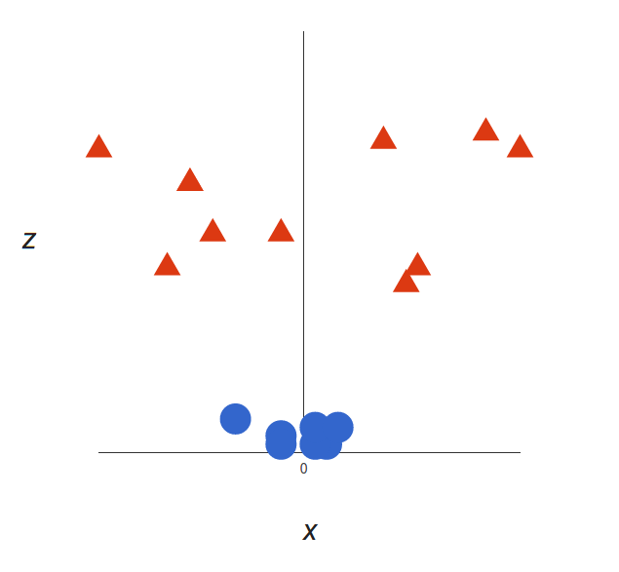
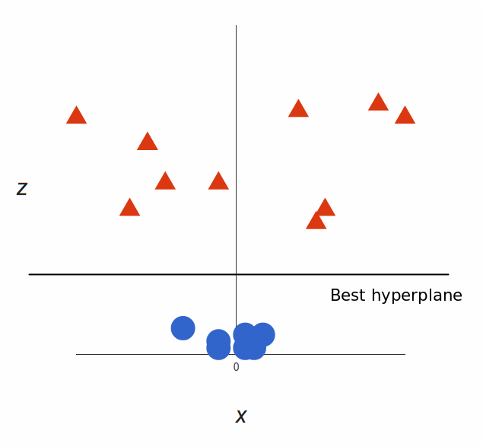

Nonlinearly separable data
Solution is to add a third dimension.
Let this third dimension be $Z=X^{2}+Y^{2}$

Slide 9
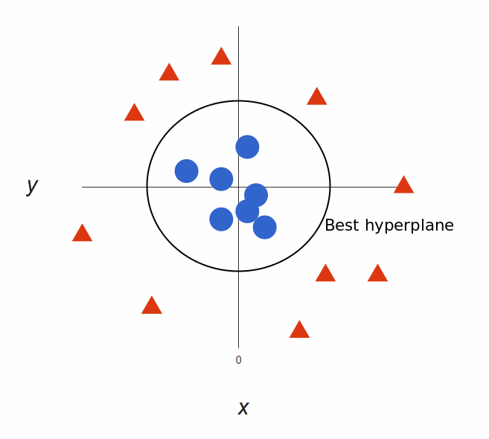
Mapping it back to two dimensions
This type of projection to higher dimensional could be very expensive computationally for large dimensional data.
Kernel trick:
A function which takes low dimensional input space with linearly non-separable data and maps it to higher dimensional space such that data is linearly separable.

Slide 10
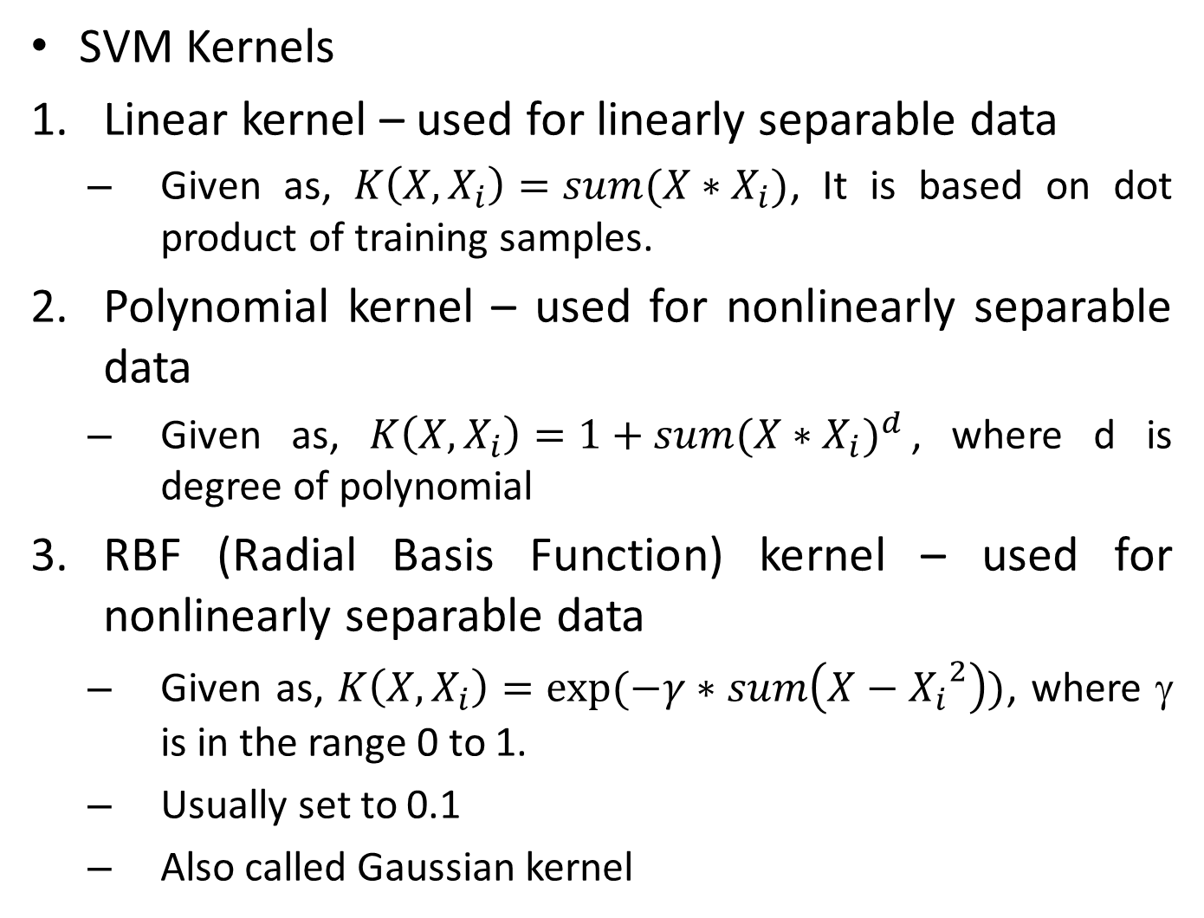
SVM Kernels
Linear kernel – used for linearly separable data
Given as, $K\left(X,X_{i}\right)=sum(X∗X_{i})$, It is based on dot product of training samples.
Polynomial kernel – used for nonlinearly separable data
Given as, $K\left(X,X_{i}\right)=1+sum{(X∗X_{i})}^{d}$, where d is degree of polynomial
RBF (Radial Basis Function) kernel – used for nonlinearly separable data
Given as, $K\left(X,X_{i}\right)=exp⁡(−γ∗sum\left(X−{X_{i}}^{2}\right))$, where γ is in the range 0 to 1.
Usually set to 0.1
Also called Gaussian kernel

